Slide 1
E: Track II Project level analyses
Robert Lempert, RAND

Slide 2
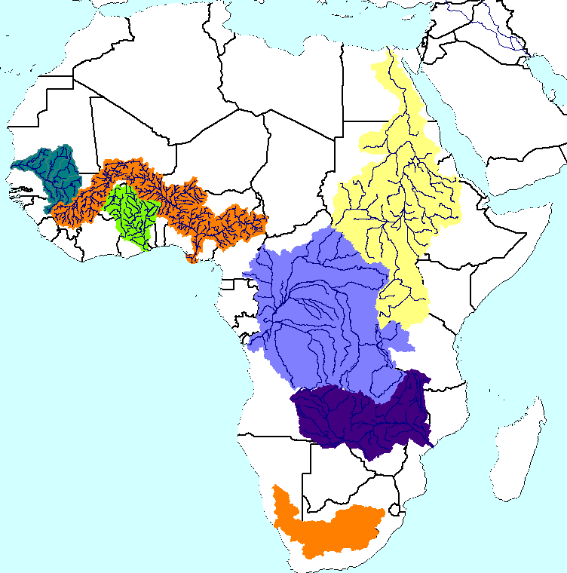
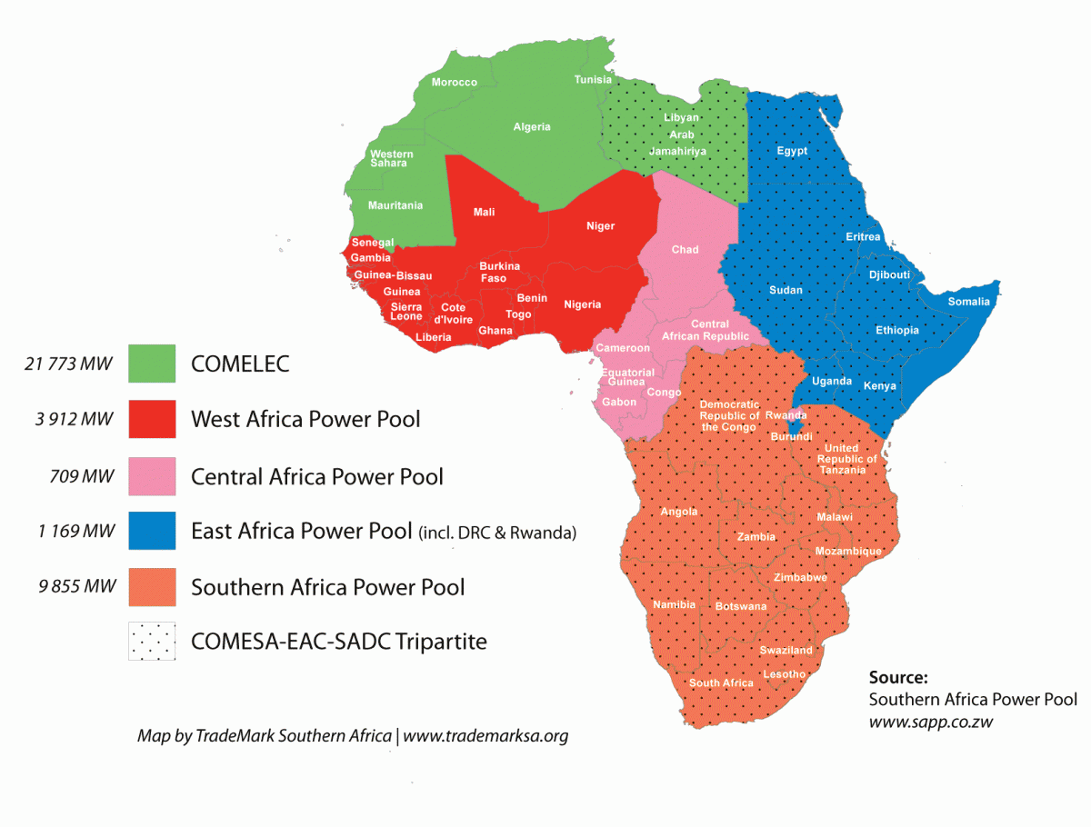
Project Has Two Tracks
Analyses consistent across basins and power pools (Track I)
Water
Energy

Slide 3
Project Has Two Tracks
Analyses consistent across basins and power pools (Track I)
Project level analyses (Track II)
Conduct five case studies, each focusing on a specific project
Goals of project-level analyses:
Benefit managers of the projects studied
Enrich response options analysis in basin-level studies
Develop widely usable tools Bank and others can use

Slide 4
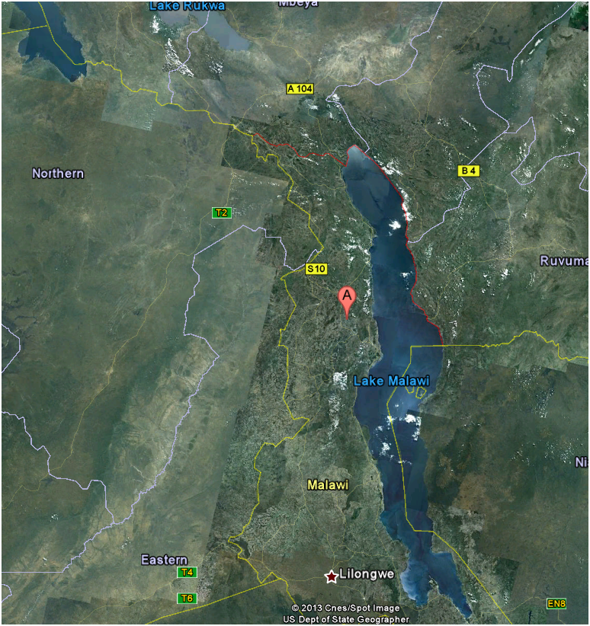
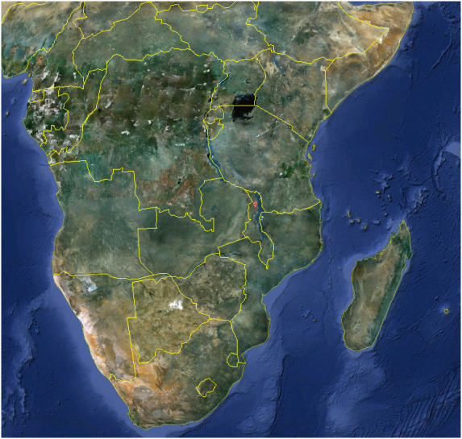
Initial Case Study Considers Malawi’s Lower Fufu Hydro-Power Project
Project basics:
Hydropower (90 MW)
Estimated cost: $600M
Performance metrics
Firm power (MWh / yr)
Levelized energy cost (US$/ KWh)

Slide 5
Analysis Builds on Data in 1995 Prefeasibility Report
Estimates from 1995 report:
Capital cost: $118.75M
Annual fixed operating costs: $1.78M/year (roughly 1.5% of capital cost)

Slide 6
Analysis Will Stress-Test Project Across Wide Range of Plausible Futures
Analytic Approach
Use hydrological and financial model to evaluate performance metrics under many future conditions (climate and other uncertain variables)
Identify cases where performance is unacceptably low
Consider design choices that can reduce vulnerability in as many cases as possible
Design choices include
Plant capacity
Height of dams
Diameter of supply tunnels

Slide 7
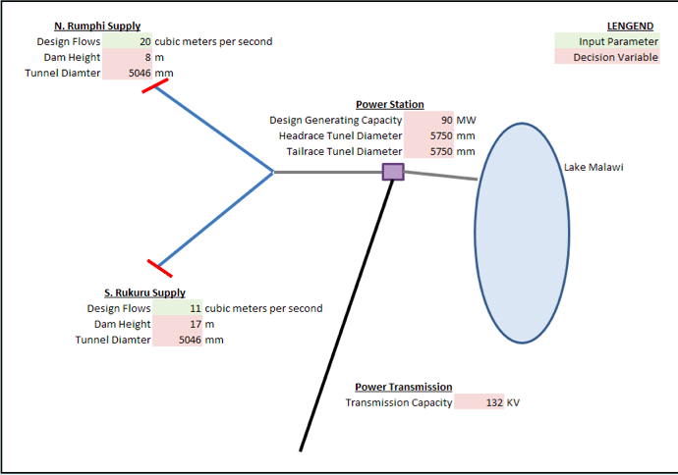
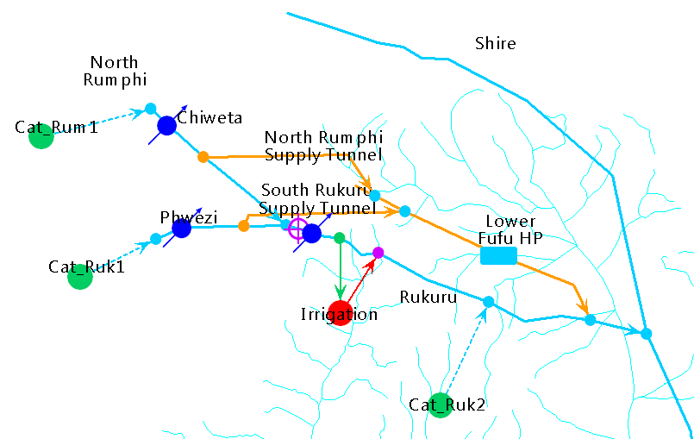
Built Simple Analytic Framework for Evaluating the Robustness of Lower Fufu Hydropower Project
Excel model of hydro project costs
Financial and other
assumptions
Which project
specifications
are most robust
in terms of firm
yields and energy
costs?
Excel-based hydropower
project cost model
Alternative hydropower
project specifications
Capital costs
O&M costs
WEAP model of hydro project
By project specification
and climate and other
assumptions:
Firm yield
Unit costs
Climate change
hydrologies
Other assumptions

Slide 8
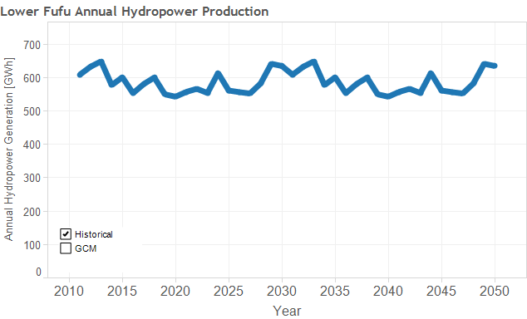
Simulated Hydropower Production Over Time: Historical Climate
Historical
56 GCM Projections
+ Historical

Slide 9
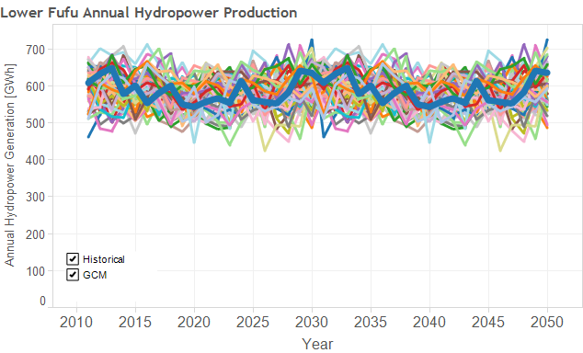
Simulated Hydropower Production Over Time: 56 Climate Projections
Historical
56 GCM Projections
+ Historical

Slide 10
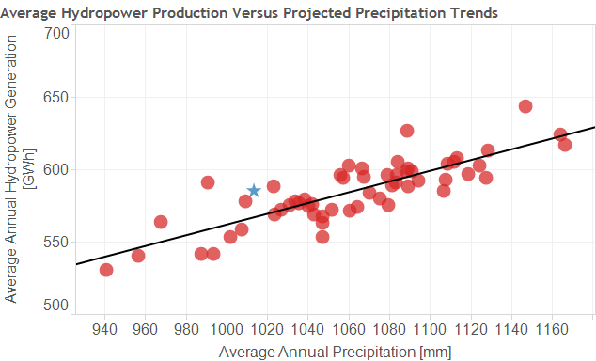
Average Hydropower Production Varies Across Climate Projections
56 GCM Projections
+ Historical
Average Annual Hydropower
Production Range:
530 – 644 GWh

Slide 11
With Current Project Configuration Hydropower Unit Costs Vary Across Climate Projections
Annual costs assuming 5% annual interest rate and 40-year payback period:
$12.4M (capital costs) + $1.3M (O&M costs) = $13.6M/year
Annual production range:
530 – 644 GWh
Range in Energy costs:
0.021~ 0.026 $/kWh

Slide 12
Next Steps to Consider on Fufu Case Studies
Additional uncertainties
Hydraulic efficiency (nominal is 88%)
Infrastructure cost parameters
Financial terms
Larger instream flow requirements (reduce diversion potential)
Demand for power at required price
Alternative project designs
Larger and smaller supply tunnels
Larger and smaller generating capacity
Alternative energy sources

Slide 13
Some Criteria for Choosing Next Four Case Studies
Project in one of the seven basins considered in Track I analyses
Project between pre-feasibility and feasibility study phases
Sufficient data in pre-feasibility study to inform the simple, excel-based model
Interest among relevant decision makers

